Slide 1
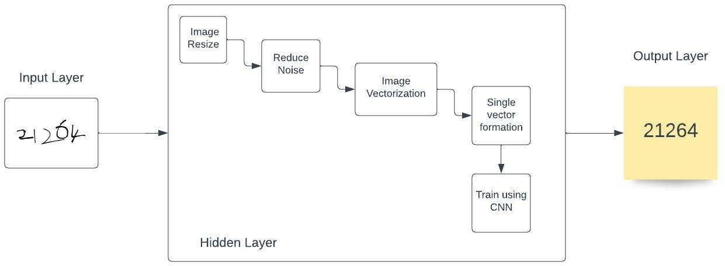
Project Design Phase-II Technology Stack (Architecture & Stack)
Date | 15 October 2022
Team ID | PNT2022TMID45157
Project Name | Project - A Novel Method for Handwritten Digit Recognition System
Maximum Marks | 4 Marks
Technical Architecture:
Table - 1: Components & Technologies:
S.No | Component | Description | Technology
1. | User Interface | How user interacts with application | React JS
2. | Application Logic-1 | Logic for a process in the application | Python

Slide 2
3. | Cloud Database | Database Service on Cloud | IBM DB2, IBM Cloudant etc.
4. | Machine Learning Model | Purpose of Machine Learning Model | Image Recognition Model (CNN)
5. | Infrastructure (Server / Cloud) | Application Deployment on Cloud | IBM Cloud
Table-2: Application Characteristics:
S.No | Characteristics | Description | Technology
1. | Open-Source Frameworks | List the open-source frameworks used | Keras, tensorflow, pandas, numpy
2. | Scalable Architecture | Justify the scalability of architecture (3 – tier, Micro-services) | Flask Microservice

